Slide 1
Information Retrieval Project
Epic Q/A - Passage Retrieval
Lahari Sreeja - 12041570
Riyanshi Goyal - 12041240
Yedla Usha Sri - 12041780
Ankita Kumari - 12040220

Slide 2
In response to the COVID-19 pandemic, the Epidemic Question Answering (EPIC-QA) has to develop models capable of automatically answering ad-hoc questions about the disease COVID-19, its causal virus SARS-CoV-2, related corona viruses, and the recommended response to the pandemic.
The EPIC-QA project involves two tasks:
Task A : Expert QA: In Task A, we are provided with a set of questions asked by experts and are asked to provide a ranked list of expert-level answers to each question useful to researchers, scientists, or clinicians.
Task B : Consumer QA: In Task B, we are provided with a set of questions asked by consumers and are asked to provide a ranked list of consumer-friendly answers to each question understandable by public.

Slide 3
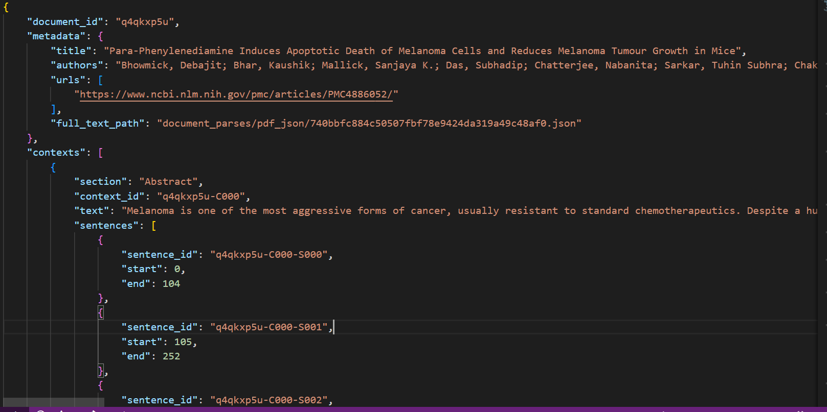
Data

Slide 4
1. Extracting
Relevant Documents
Extracting relevant documents for the given query

Slide 5
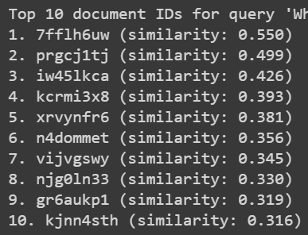
Top ten documents retrieved for each query
The questions of the documents were extracted from title section in data given to us.
We used the given consumer/expert questions as queries, compared them with extracted questions from data and ranked the top ten documents using different models.

Slide 6
2.
Extracting passage answers for queries
Extracting answers from the top documents retrieved.

Slide 7
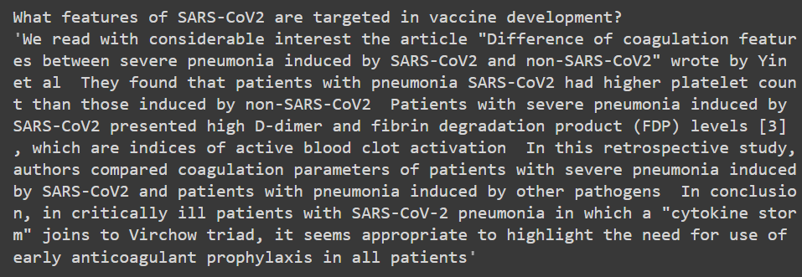
Extracting passage answers from documents retrieved
In this part we take a question as input and returns an answer.
We used different models to calculate the similarity between the query and the sentences in the documents and extracts the top 5 most relevant sentences and merges them into a paragraph to form the passage answer.

Slide 8
3.
Different Models Used for retrieval

Slide 9
Different Models Used
TfidfVectorizer:
A tool used for converting text documents into numerical representations based on term frequency and inverse document frequency.
BERT:
Bidirectional Encoder Representations from Transformers, a pre-trained language model used for various natural language processing tasks.
Universal Sentence Encoder:
A pre-trained deep learning model used for encoding sentences and creating high-quality representations of text for different NLP tasks.
Doc2Vec:
A neural network-based algorithm used for generating fixed-length vectors representing documents and words in a way that preserves their contextual meaning.

Slide 10
Novelty in our Project
We utilized different models in passage retrieval project,namely TfidfVectorizer,Universal Sentence Encoder,Doc2Vec,BERT.
The relevant documents retrieved for the given queries matched with the requirements and the answers we extracted using the four different models were satisfactory.
Both the Consumer and Expert Data sets were explored and passage answers for each dataset were extracted according to requirement.

Slide 11
Thanks!

